Slide 1
Kanban Policy Game
Practice evolutionary change in the context of a knowledge discovery process

Slide 2
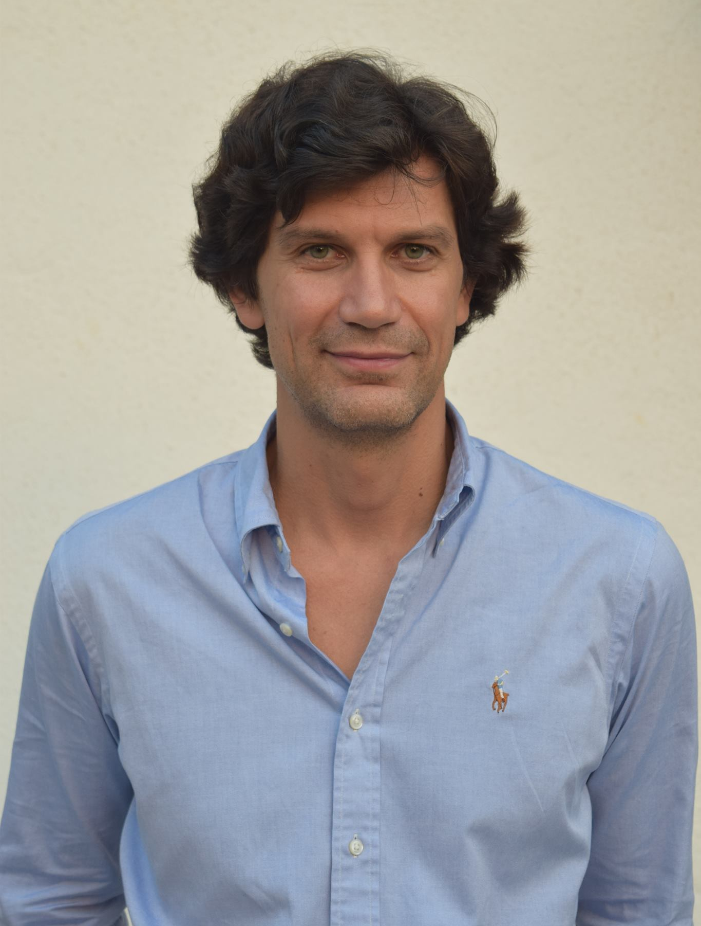
Dimitar Bakardzhiev is an expert in managing successful and cost-effective technology development. With his blend of technical, managerial and operational expertise, he effectively combines the theory and practice of Agile and Kanban Method to deliver business results.
As a Accredited Kanban Trainer (AKT), Kanban Coaching Professional (KCP), expert Kanban practitioner and Brickell Key Award 2015 Finalist, Dimitar puts Kanban to work every day when managing complex software projects. Dimitar has published David Anderson’s Kanban book as well as books on Lean, Theory of Constraints by Goldratt and Deming's Theory of Management in the Bulgarian language.
@dimiterbak

Slide 3
Agenda
Present the goal and the scientific models behind Kanban Policy Game – to understand why, how and when if at all you should us it.
Present the Kanban Policy Game.
Present the results from a software simulation of the game.
Play the game.

Slide 4
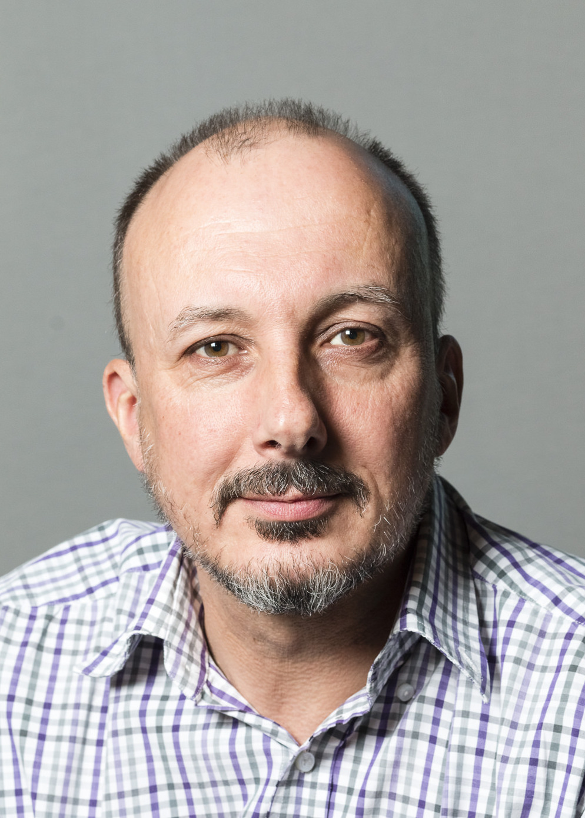
Kanban Policy Game borrowed from Featureban. Thank you Mike!
Featureban is a game created by Mike Burrows.
The goal of Featureban is to show how by limiting WIP teams can relieve themselves from overburdening.
Featureban is licensed under a Creative Commons Attribution-ShareAlike 4.0 International License.

Slide 5
Kanban Policy Game is licensed under a Creative Commons Attribution-ShareAlike 4.0 International License. Customisation is encouraged!

Slide 6
The goal of the Kanban Policy Game is to let people practice evolutionary change in the context of a knowledge discovery process.

Slide 7
Evolutionary Change
Kanban Policy Game

Slide 8
The Traditional View of how Change Happens
There
Transition
Here
Notes:
Traditional change is an A to B process. A is where you are now. B is a destination. B is either defined (from a methodology definition) or designed (by tailoring a framework).
To get from A to B, a change agency* will guide a transition initiative to install destination B into the organization.
*either an internal SEPG or external consultants.
This time however,
instead of walking, imagine you have a very powerful pogo stick. When
you push a button on the pogo stick, it launches you in a random direction
over a random distance. Thus, you keep hitting the button hoping to land on
a high spot. This strategy is called a random jump (figure 9-8). The random
jump has the advantage over the adaptive walk of not getting stuck on local
maxima-you might hop clear over the intervening valley from a low peak to
a higher peak. However, it also has the disadvantage that you might also find
yourself down in a death valley.

Slide 9
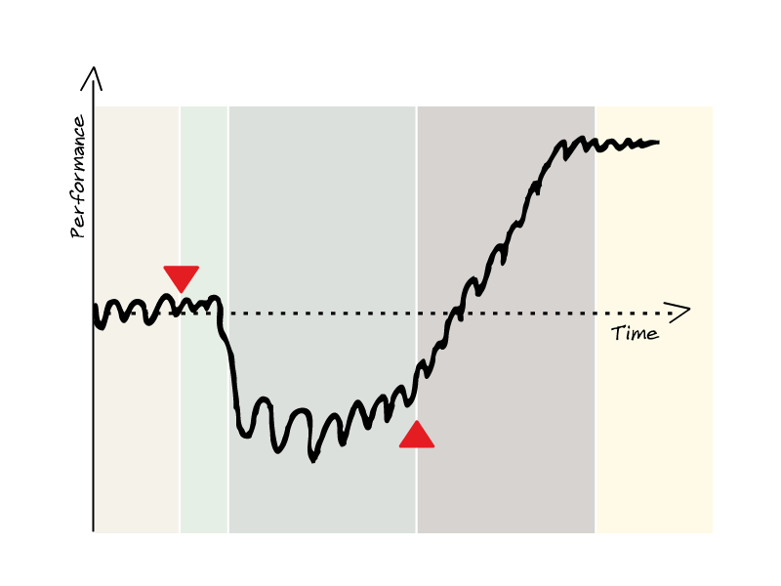
What change really feels like: The J Curve
Attribution: LKU

Slide 10
What change really feels like: The J Curve
Safety!
Attribution: LKU

Slide 11
What change really feels like: The J Curve
Patience!
Attribution: LKU

Slide 12
Evolutionary change - small steps in a direction
Initial
Process
Evaluate
Fitness
We don’t know the end-point but we do know our emergent process is fitter!
Evaluate
Fitness
Evaluate
Fitness
Roll back
Roll forward
Evaluate
Fitness
Evolve
Process
Evaluate
Fitness
Future process is emergent
Attribution: LKU
Notes:
The Kanban Method rejects the traditional change management method and rejects the installation of a new style of working - a new methodology. It does this because it is better to avoid resistance than to push harder against it.
The Kanban Method introduces an evolutionary approach to change that is humane. It is designed to work with carbon-based life forms processing change with system 1. The Kanban Method catalyzes improvement through the use of kanban systems and visual boards.
Evolutionary means that there is no pre-defined target state we could define upfront before we start our change initiative. Instead, we set a direction (i.e. vision) and then continuously improve our system in that direction. So the outcomes are fixed, but the way we are going to achieve these outcomes need yet to be explored - and they might also change all the time.

Slide 13
"When you want to make a change, first, make the change easy. (Warning, this may be hard.) Then make the easy change.” ~ Kent Beck
Notes:
Kent Beck summarizes this. "When you want to make a change, first, make the change easy. (Warning, this may be hard.) Then make the easy change".
"I'm refactoring our software at the moment, so it's going to be broken for the next two weeks." Bzzz - that's not refactoring. Refactoring is small changes, each of which keeps everything working. It doesn't change the observable behavior of the software, that's its definition.

Slide 14
Cheap changes are easy to rollback
Hiring new people is not cheap.
Building a new office is not cheap.
Changing policies is usually cheap.

Slide 15
knowledge discovery process
Kanban Policy Game

Slide 16
Discoveries are a natural part of any knowledge work.

Slide 17
Product development is the process of going from 0% knowledge about an idea to 100% knowledge of a finished product ready for delivery to a customer.
Michael Kennedy

Slide 18
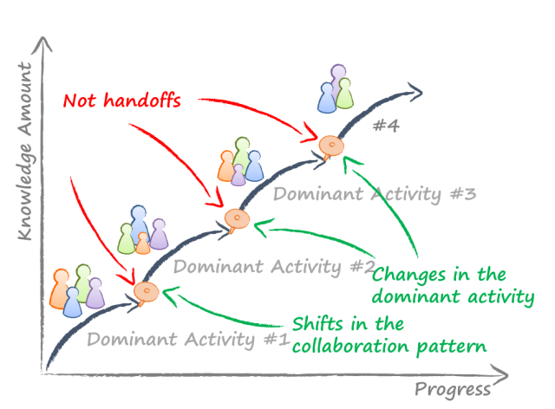
Knowledge discovery process diagram
https://connected-knowledge.com/2016/09/21/knowledge-discovery-process-revisited/

Slide 19
Knowledge discovery process is a punctuated information arrival process molded by the dominant information discovery activity at any given time.
David J. Anderson
http://www.djaa.com/understanding-process-knowledge-discovery

Slide 20
How does the information arrive into the process?

Slide 21
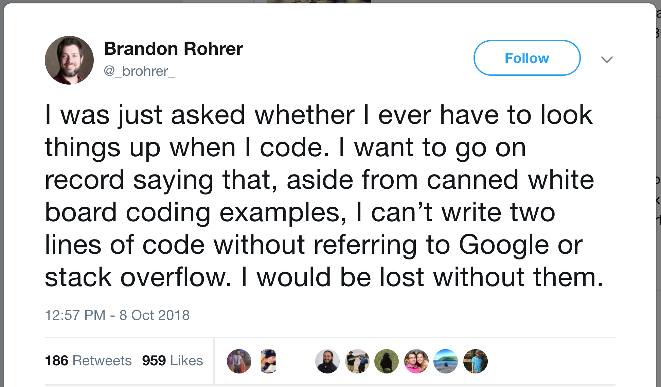

Slide 22
The knowledge workers serve as a communication channel that transmits information from the environment into the physical part of knowledge work items.

Slide 23
A very large number of knowledge workers do both knowledge work and manual work. I call them “technologists.” This group includes people who apply knowledge of the highest order…. Technologists may be the single biggest group of knowledge workers.
Drucker, Peter F. "Knowledge-worker productivity: The biggest challenge." California management review 41.2 (1999): 79-94.

Slide 24

Knowledge work is invisible

Slide 25
Manual work is visible
Margaret Hamilton, whose handwritten code saved the moon landing in 1969, was awarded the Presidential Medal of Freedom today by Barack Obama.
In the picture on the left she is standing next to the navigation software that she and her MIT team produced for the Apollo project.

Slide 26
Work
We are separating the physical part from the knowledge part of any work.
The physical part is the writing of all those sheets of paper Margaret stands next to. The physical work involves no thinking – just writing.
The knowledge part is invisible – it is all the thoughts, ideas, information there are in all those sheets of paper Margaret stands next to.

Slide 27
How can we model the knowledge discovery process?

Slide 28
Information arrival
A set of 0s and 1s represent all the information that arrives through particular worker and thus affects the flow of physical work.
1s are favorable i.e. they provide the worker with the information needed to continue the physical work.
0s are unfavorable i.e. they block the worker from continuing the physical work. Such unfavorable events are called blockers.

Slide 29
Types of Blockers (0s)
Lack of information needed to proceed with a work item. The information is expected from the people that requested the work item to be built.
Lack of technical knowledge needed by worker in order to do his job. That is very common in knowledge work e.g. technologies are constantly changing and maturing.
Need to block a card in order to start another card. Essentially multitasking.

Slide 30
Dependencies and skills
A dependency to another team, card, product will be signaled as a 0/1 event from the environment.
If we have a very senior and very knowledgeable worker we model this by making the environment send more 1s than 0s to that senior worker.

Slide 31
Laminar Flow of Work
Work request #1
Work #1 delivered
. . . .
. . . .
Work request #N
Work #N delivered
Infomation
1,1,1,1
1,1,1,1
1,1,1,1
1,1,1,1
1,1,1,1

Slide 32
Turbulent Flow of Work
Work request #1
Work #1 delivered
. . . .
. . . .
Work request #N
Work #N delivered
Infomation
1,0,1,0
1,1,0,0
0,0,0,1
1,1,0,1
0,0,1,1

Slide 33
Example of a Knowledge Discovery Process
Write down Honorificabilitudinitatibus. It can be translated as “the state of being able to achieve honours”. It is mentioned by the character Costard in Act V, Scene I of William Shakespeare's Love's Labour's Lost. It is also the longest word (27 chars) in the English language featuring only alternating consonants and vowels.
What is the task?
H
o
n
o
r
i
f
i
c
a
b
i
l
i
t
u
d
i
n
i
t
a
t
i
b
u
s
1
1
1
1
1
0
1
1
1
1
1
1
0
0
1
0
0
1
0
1
0
0
0
1
1
1
1
1
1
1
1
1
1
1
1
1
1
2
3
4
5
6
7
8
9
10
11
12
13
14
15
16
17
18
19
20
21
22
23
24
25
26
27
28
29
30
31
32
33
34
35
Lead time (LT):
36
Time Units
FE = TT/LT = 27/36 = 75%
Touch time (TT)
27
Time Units
Notes:
We first need to present the difference between Output and Outcome:
* Output is everything physical produced between the initial idea and delivery.
* Outcome is what happens when the output is delivered. Outcome is experienced by the users.
Knowledge workers claim rightly so that:
* Their job is not to build more physical stuff faster i.e. to maximize output.
Their job is to maximize the outcome and impact we get from the output we choose to produce.
Some of the words are more expressive (outcome) than others and therefore say more in a fewer words (output) i.e. have greater outcome in less output.

Slide 34
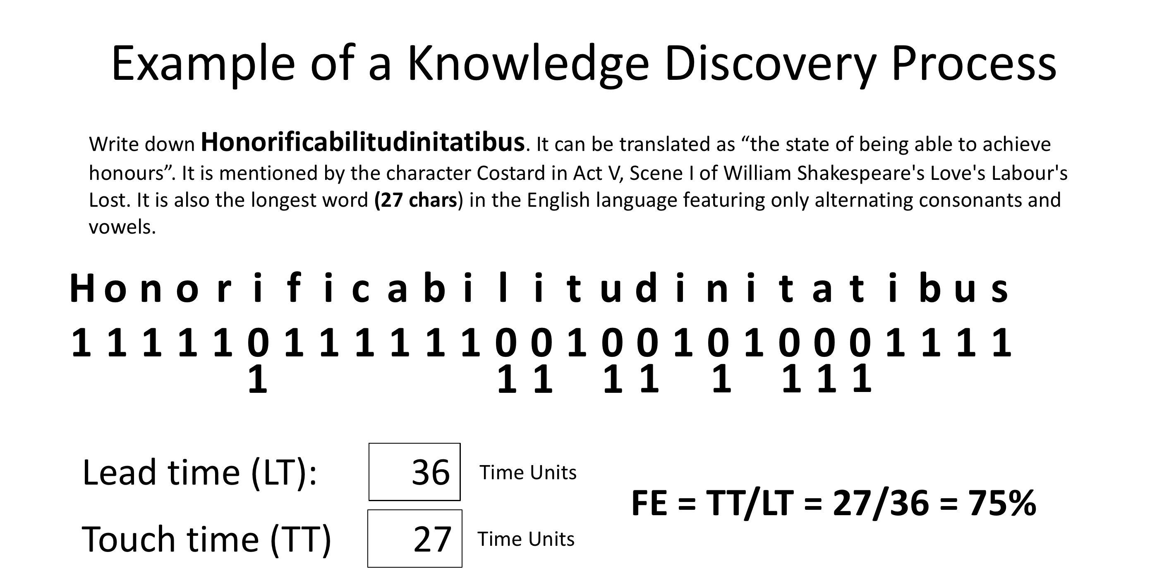

Slide 35
Modeling the knowledge discovery process in Kanban Policy Game
Kanban Policy Game

Slide 36
4
4
The dominant information discovery activities
of game’s knowledge discovery process

Slide 37
Model information arrival using Heads (1s) and Tails (0s)

Slide 38
Setup (for each period)
Get into teams of 4 people.
Generate a backlog of 20 features using post-it notes of size 51x38 mm. Write the number of each feature in the center of a sticky note, leaving room top and bottom.
Choose just one card each, write your initials in the top left corner, and put it in the second column
Leave the remainder cards in the “Ready” column.
#1

Slide 39
Roles
Team member. Starts, moves, blocks/unblocks and completes work items.
Scribe. Writes down the coin tosses (H for Heads, T for Tails) for each team member for each day in the following table:
Day # | Team Name < >
 | Team member name < > #20 | Team member name < > #21 | Team member name < > #22 | Team member name < > #23
1 | H | H | T | H
2 | T | T | T | T
………………
10 | H | T | H | T

Slide 40
Rules
You as a team have 10 days to finish 20 cards. Each day begins with a “daily meeting”. In your “daily meeting” each of the team members should:
toss a coin,
share with the other team members the result,
then move the cards on the kanban board according to the rules and the policies.

Slide 41
If you throw Heads | If you throw Tails
Do one of: Advance one of your unblocked work items rightward by following what WIP Policy says OR Unblock one of your items that is blocked and advance it rightward by following what WIP Policy says OR Start new work by following what the Pull Policy says OR help others by following what the Collaboration Policy says | Do both: Block one of your currently unblocked items if you have one AND follow what the Pull Policy says

Slide 42
Blocking
When the rules require you to block a card, mark its sticky note with a “B”. If the rules require to block a blocked one don’t put another “B”.
When the rules require you to unblock a card, do that by crossing out the existing “B” on the sticky note. Example of one that has been blocked, unblocked and re-blocked: BB
DB
DB
#1
#1
B
BB

Slide 43
Illegal moves
A card cannot be moved more than once in the same day
When you pair to help a teammate both of you are allowed to move only one card. For example:
Team member #20 has T and team member #23 has H.
They pair and #23 moves the card that belongs to #20.
After that #20 has no T left i.e. no card should be blocked and a new card started.

Slide 44
If you have Heads (H) do only one of:
4
4
#4
DB
#3
Advance
#5
DB
#2
Unblock & Advance
|
B
#6
DB
2
XY
Help somebody else
Start a new card
#1
5
#7
XY shoould not block a card and start a new card!

Slide 45
If you have Tails (T) do both…
4
4
#4
DB
#3
#5
DB
#2
Block one card
B
#6
DB
2
Start a new card
#7

Slide 46
Metrics
When start a card put the day in the upper right corner
When finish the card put the day in the lower right corner
DB
2
#1
BB
5

Slide 47
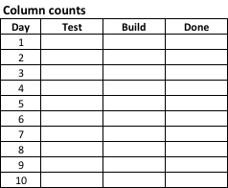
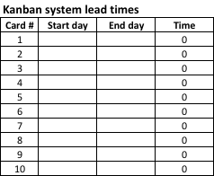
Log data and visualize in Excel

Slide 48
Modeling evolutionary change in Kanban Policy Game
Kanban Policy Game

Slide 49
Evolutionary change in three periods

Slide 50
In the first period our goal is to understand what is the current state of the system. Hence we don’t ask the organization to make any change! Just to make explicit the “Collaboration Policy”, “Pull Policy” and “WIP Policy”. We run the game for a period of 10 days. Then we measure the results in terms of average lead time and throughput and set it as baseline.

Slide 51
In the second period we ask the organization to change only the “WIP Policy” and limit the work in process for 10 days. Then we measure the results in terms of average lead time and throughput. We evaluate the fitness by comparing with Period 1 results.

Slide 52
In the third period we ask the organization to change only the “Collaboration Policy”. From now on the organization will not measure individual productivity but the performance of a team as a whole. Then we measure the results in terms of average lead time and throughput and compare with Period 2 results.

Slide 53
In order to be able to compare the results from the three periods we reuse the coin tosses (H for Heads, T for Tails) for each team member for each day from Period 1!

Slide 54
Period 1: application of Kanban Method’s three core practices
CP1: Visualize
Work items
Work flow
Work item state – where in the work flow, whether blocked
CP4: Make policies explicit
CP5: Implement feedback loops
Daily standup meeting
Notes:
The facilitator plays the role of an Agile coach who as part of the company’s Agile transformation is engaged to work with the teams playing the game.
The coach says something to the tune of the following:
“I am hired by your leadership to improve your performance. You’ve been through a two days Kanban training and you do know what the method is.
We will start by measuring how many features you’ll be able to deliver in the next 10 days.
The end goal is for us to understand where are the areas that need improvement.
I know that you want to ask me – would your managers see the measurements?
My answer is – I guess so, because we will be transparent in order to improve.
If you ask me if your managers would use the results for your monthly performance appraisals – I don’t know. But you can safely assume it is highly likely they would.”
I have been looking around the place and talking to people in order to get myself familiar with the polices of your organization. Here are the policies I found to be in use in your organization:

Slide 55
Here are the policies in use in the organization
Collaboration Policy | Pull Policy | WIP Policy
We measure the individual productivity of the team members. Your goal is the Done column to have your name on as many work items as possible. Hence only if you have no other options, pair up with someone who threw tails and move on their behalf. Note: Follow the “WIP Policy” in regards the amount of work in process. | We want our resources to be fully utilized. Hence when their current work item is blocked team members should start working on a new work item by initial it and move to the Build column. Note: Follow the “WIP Policy” in regards the amount of work in process. | We can have unlimited number of work items in each of the columns.

Slide 56
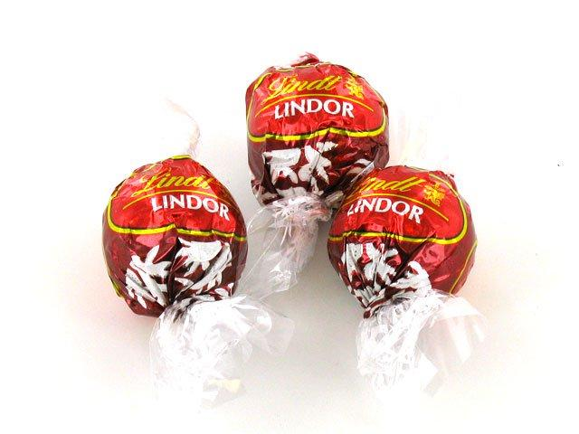
Foster no-collaboration by offering a chocolate as a bonus to the best performer on the team!

Slide 57
If you throw Heads | If you throw Tails
Do one of: Advance one of your unblocked work items rightward by following what WIP Policy says OR Unblock one of your items that is blocked and advance it rightward by following what WIP Policy says OR Start new work by following what the Pull Policy says OR help others by following what the Collaboration Policy says | Do both: Block one of your currently unblocked items if you have one AND follow what the Pull Policy says

Slide 58
Reward the best
End of Period 1
Notes:
At the end of the period the facilitator will play the role of the management. The results of the game will be used for the performance appraisals.
The players who had the most cards under their names will be presented with a bonus in the form of a candy.

Slide 59
Debrief
In your teams, list and prepare to report back:
Concepts, practices, and outcomes simulated in the game
Your observations
Workplace parallels

Slide 60
Confirm the application of Kanban Method’s three core practices
CP1: Visualize
Work items
Work flow
Work item state – where in the work flow, whether blocked
CP4: Make policies explicit
CP5: Implement feedback loops
Daily standup meeting

Slide 61
Debrief results – Lead Time

Slide 62
Debrief results - Throughput

Slide 63
Keep the coin tosses (H for Heads, T for Tails) for each team member for each day!

Slide 64
Period 2: application of Kanban Method’s next two core practices
CP2: Limit work-in-process (WIP)
Column limits, one way to balance workload vs capacity
We made a true kanban system (pull and limiting WIP)
CP3: Manage flow
Flow (smoothness, timeliness, economic outcomes)

Slide 65
Reuse the coin tosses (H for Heads, T for Tails) for each team member for each day from Period 1!

Slide 66
We make one policy change
Collaboration Policy | Pull Policy | WIP Policy
We measure the individual productivity of the team members. Your goal is the Done column to have your name on as many work items as possible. Hence only if you have no other options, pair up with someone who threw tails and move on their behalf. Note: Follow the “WIP Policy” in regards the amount of work in process. | We want our resources to be fully utilized. Hence when their current work item is blocked team members should start working on a new work item by initial it and move to the Build column. Note: Follow the “WIP Policy” in regards the amount of work in process. | For each of the columns we are limiting our work in process to equal the number of team members. As a result only if a column has free capacity you can advance one of your cards rightwards.

Slide 67
Only one change since the previous period
Coin tosses (the nature of work) – the same, not changed.
The team – the same, not changed.
Collaboration policy – the same, not changed.
Pull policy – the same, not changed.
WIP policy – CHANGED!

Slide 68
Foster no-collaboration by offering a chocolate as a bonus to the best performer on the team!

Slide 69
If you throw Heads | If you throw Tails
Do one of: Advance one of your unblocked work items rightward by following what WIP Policy says OR Unblock one of your items that is blocked and advance it rightward by following what WIP Policy says OR Start new work by following what the Pull Policy says OR help others by following what the Collaboration Policy says | Do both: Block one of your currently unblocked items if you have one AND follow what the Pull Policy says

Slide 70
Reward the best
End of Period 1
Notes:
At the end of the period the facilitator will play the role of the management. The results of the game will be used for the performance appraisals.
The players who had the most cards under their names will be presented with a bonus in the form of a candy.

Slide 71
Debrief
In your teams, list and prepare to report back:
Concepts, practices, and outcomes simulated in the game
Your observations
Workplace parallels

Slide 72
Confirm the application of Kanban Method’s two core practices
CP2: Limit work-in-process (WIP)
Column limits, one way to balance workload vs capacity
We made a true kanban system (pull and limiting WIP)
CP3: Manage flow
Flow (smoothness, timeliness, economic outcomes)

Slide 73
Debrief results – Lead Time

Slide 74
Debrief results - Throughput

Slide 75
Period 3: Collaboration allowed – application of Kanban Method’s last core practice
CP6: Improve collaboratively, evolve experimentally (using models and the scientific method)
We created conditions for collaboration in delivery

Slide 76
Reuse the coin tosses (H for Heads, T for Tails) for each team member for each day from Period 1!

Slide 77
We make another policy change
Collaboration Policy | Pull Policy | WIP Policy
We don’t measure individual productivity but the productivity of the team as a whole. Your goal is the Done column to have as many work items as possible no matter the name on them. Hence, If you want to help the team, pair up with someone who threw tails and move on their behalf . Note: Follow the “WIP Policy” in regards the amount of work in process. | We want our resources to be fully utilized. Hence when their current work item is blocked team members should start working on a new work item by initial it and move to the Build column. Note: Follow the “WIP Policy” in regards the amount of work in process. | We are limiting our work in process to 1 item per team member for each of the columns. As a result only if a column has free capacity you can advance one of your cards rightwards.
Notes:
We removed “and you have no other options” part from the Collaboration Policy. Everything else is the same.

Slide 78
Only one change since the previous period
Coin tosses (the nature of work) – the same, not changed.
The team – the same, not changed.
Collaboration policy – CHANGED!
Pull policy – the same, not changed.
WIP policy – the same, not changed.

Slide 79
If you throw Heads | If you throw Tails
Do one of: Advance one of your unblocked work items rightward by following what WIP Policy says OR Unblock one of your items that is blocked and advance it rightward by following what WIP Policy says OR Start new work by following what the Pull Policy says OR help others by following what the Collaboration Policy says | Do both: Block one of your currently unblocked items if you have one AND follow what the Pull Policy says

Slide 80
Reward the TEAM!
End of Period 1
Notes:
At the end of the period the facilitator will play the role of the management. The results of the game will be used for the performance appraisals.
The players who had the most cards under their names will be presented with a bonus in the form of a candy.

Slide 81
Debrief
In your teams, list and prepare to report back:
Concepts, practices, and outcomes simulated in the game
Your observations
Workplace parallels

Slide 82
Confirm the application of Kanban Method’s last core practice
CP6: Improve collaboratively, evolve experimentally (using models and the scientific method)
We created conditions for collaboration in delivery
Nothing collaborative, experimental or scientific about our change

Slide 83
Debrief results – Lead Time

Slide 84
Debrief results - Throughput

Slide 85
Final debrief
Notes:
After Period 3 is finished hold a final debrief. Ask all teams playing the game to share their results and reflect on them through the lens of the J-curve model of change.

Slide 86
Final results

Slide 87
And Flow Efficiency…

Slide 88
Share the results if many teams are playing the game

Slide 89
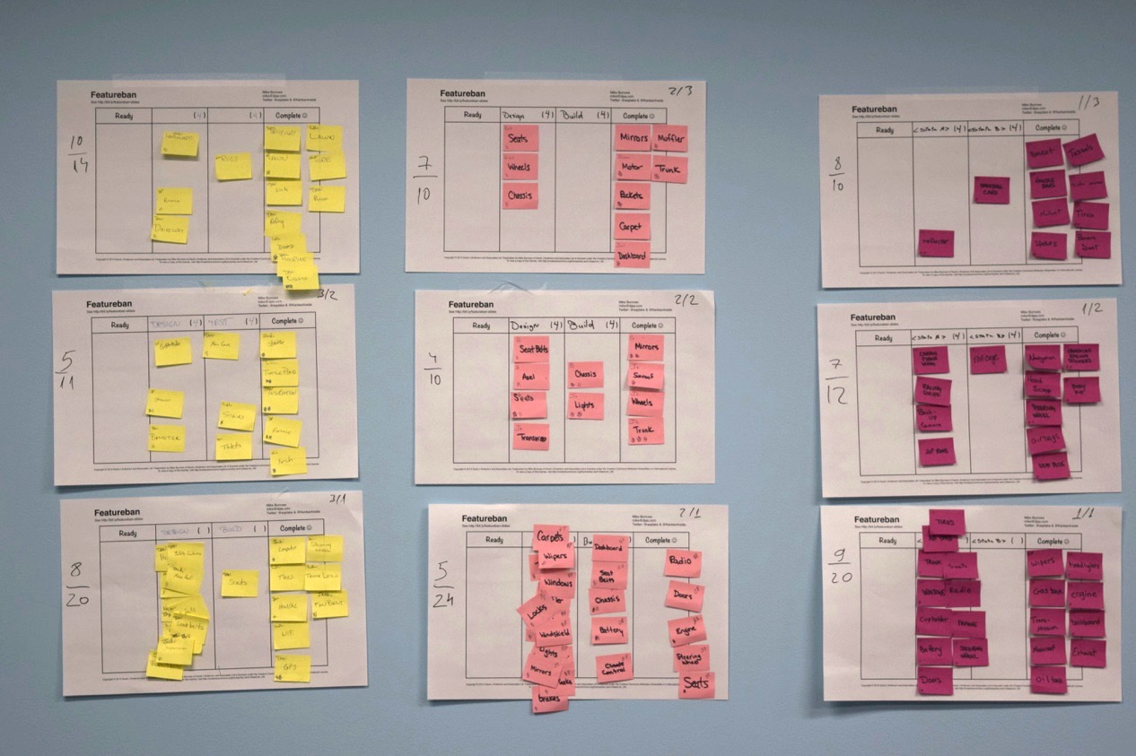
Present all the boards

Slide 92
The J-Curve Effect
Safety!
Patience!
Virginia Satir’s J- Curve Model of Change
Notes:
A capability might be lead time, or quality, or due date performance or performance against an SLA.
The current capability or fitness level is shown as the horizontal oscillating curve on the diagram. This level of capability is delivered by the current process. The model assumes that the current level of capability is not sufficient and isn’t fit for purpose, so we are motivated to improve. Once we start the change initiative the current level of capability falls. We can measure the depth of the drop as the negative delta in capability. The depth and length of the drop incurred by the change can be thought of as the pain of change. If things go well then we gradually recover back to our previous level of capability and eventually we achieve a new improved level of capability.
It is the drop in capability and the eventual improvement that gives the concept its name – “the J-curve effect.”

Slide 93
Software Simulation
Kanban Policy Game

Slide 94
The goal is to evaluate how different levels of collaboration and WIP affect Throughput and Lead Time.

Slide 95
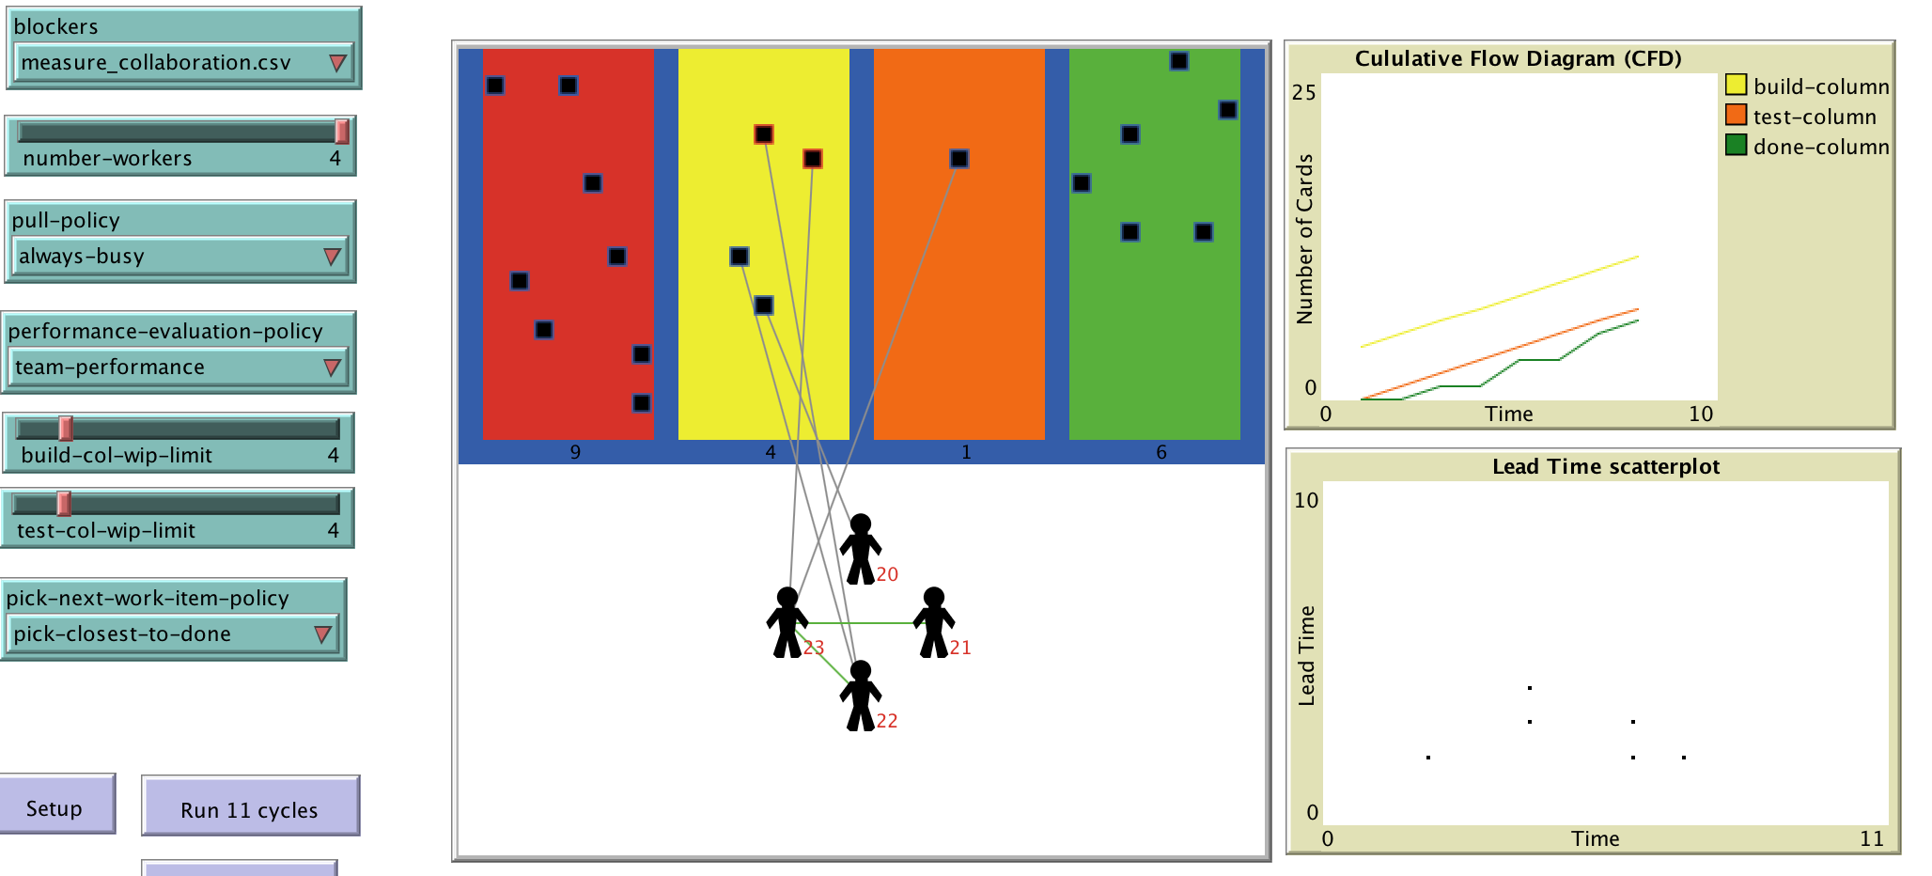
Created in NetLogo

Slide 96
Modelling the Collaboration policy
The collaboration in the team is modeled by the collaborative relationships
A worker has a collaborative relationship with another worker if both ends of the link:
Are able to find out (see, hear) if the other end needs help
Are willing to help the other end
Are able to help the other end

Slide 97
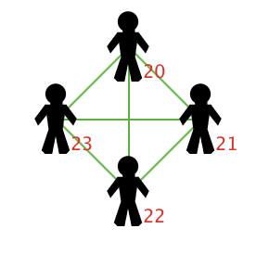
Collaborative relationships
Max 6 relationships because n( n-1)/2
Each worker has an ID number

Slide 98
What the collaboration level depends on?
Requirements for collaboration | Means to fulfil
Able to find out (see, hear) if the other end needs help | Feedback loops
Willing to help the other end | Performance evaluation policy
Able to help the other end | Positive event (1) from environment

Slide 99
Simulation parameters
number-workers = 4
performance-evaluation-policy = "individual-performance" "team-performance"
build-col-wip-limit = 20 4
test-col-wip-limit = 20 4
pull-policy = "always-busy"
pick-next-work-item-policy = "pick-closest-to-done"
touch-card-once-in-cycle = true
workers-0-and-1-connected = true false
workers-0-and-2-connected = true false
workers-0-and-3-connected = true false
workers-1-and-3-connected = true false
workers-1-and-2-connected = true false
workers-2-and-3-connected = true false

Slide 100
We run each combination of input parameters 50 times.
Total is 25, 600 number of runs.

Slide 101
performance results not split by performance evaluation policy

Slide 102
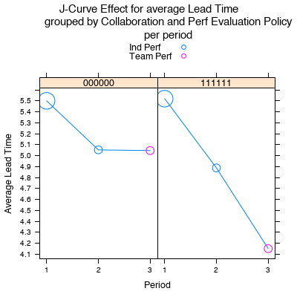
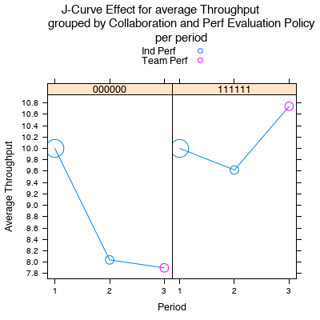
The size of the points reflects the level of WIP for the particular period. The biggest point means No WIP.

Slide 103
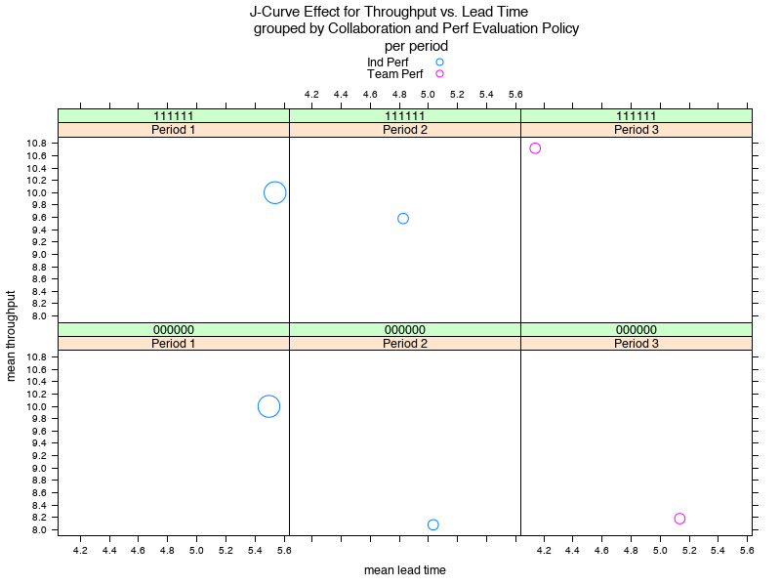

Slide 104
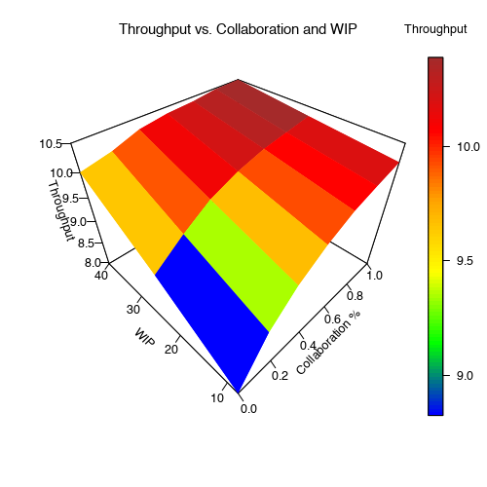

Slide 105
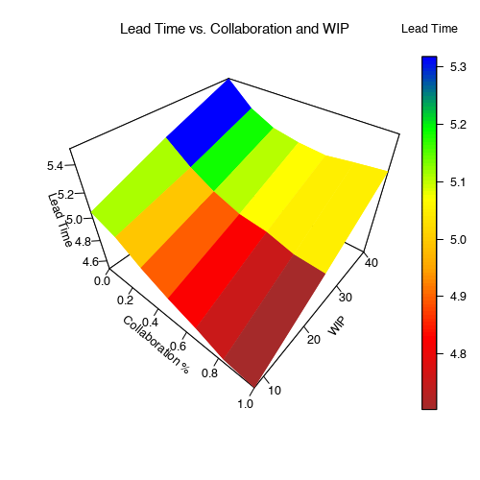

Slide 106
Team performance evaluation policy

Slide 107
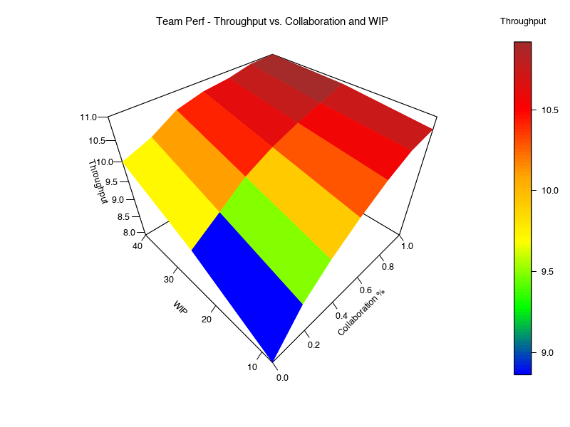

Slide 108
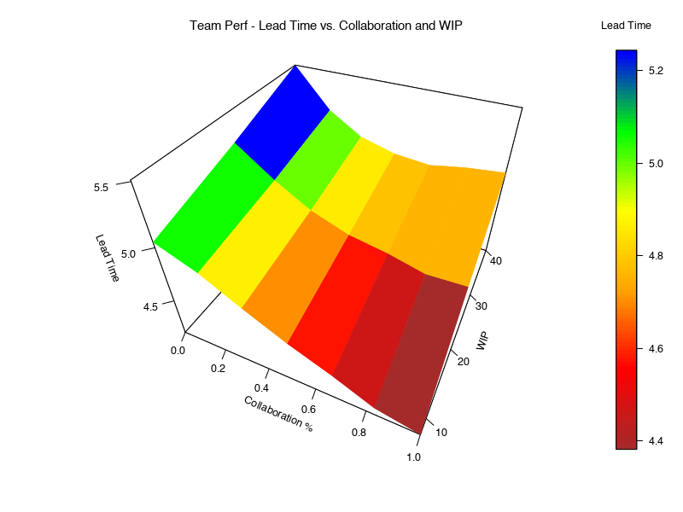

Slide 109
Conclusions about Team Performance evaluation policy
With strong collaboration irrespective of WIP limits Throughput is close to the highest possible values.
If no collaboration then limiting WIP hurts Throughput.
The team needs only strong collaboration to achieve good Throughput and Lead Time – highly unlikely to get poor performance by chance.
To achieve shortest possible Lead Time strong collaboration is not enough – WIP must be limited as well.

Slide 110
Individual performance evaluation policy

Slide 111
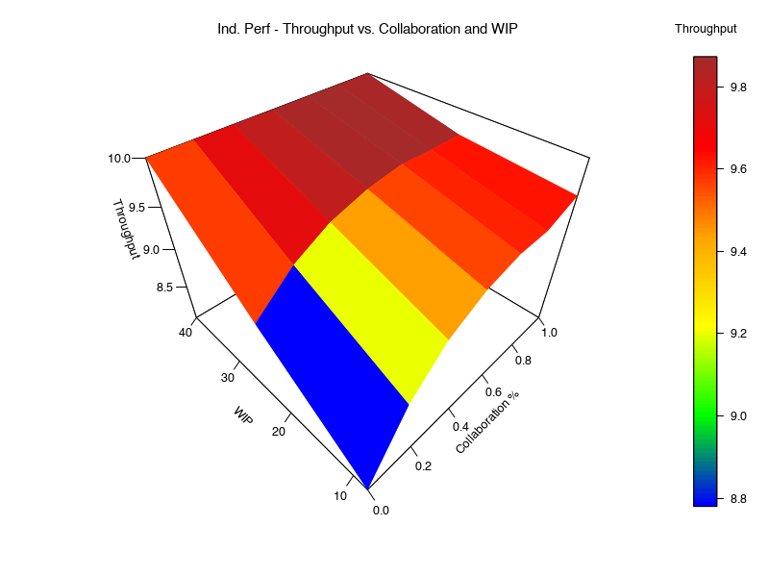
Notes:
There us a phase shift, a cliff at around 25 WIP

Slide 112
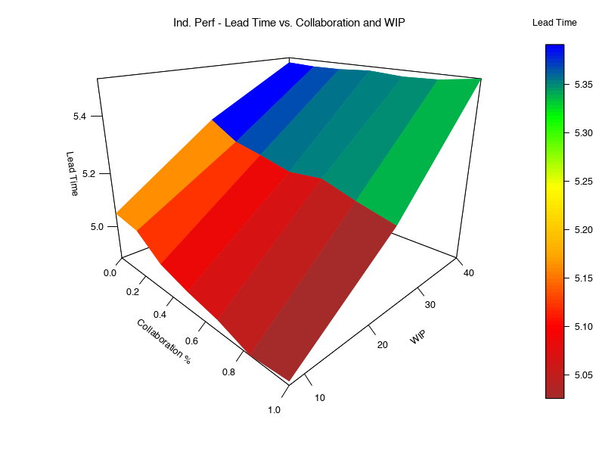
Notes:
There is a phase shift at around 25 WIP

Slide 113
Conclusions about Individual Performance
To achieve close to highest Throughput only strong collaboration is needed
To achieve highest possible Throughput we need unlimited WIP only.
The achieve shortest possible Lead Time strong collaboration is not enough – WIP must be limited as well

Slide 114
Takeaways
When we limit WIP in a no-collaboration context, then throughput goes down.
At the same time if we want collaboration in a context we have to limit WIP.
We use Kanban to balance the first two points and find the sweet spot.

Slide 115
Let’s play the game!

